Slide 1
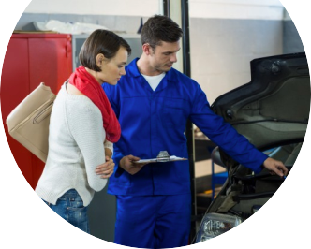
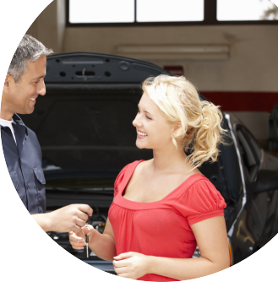

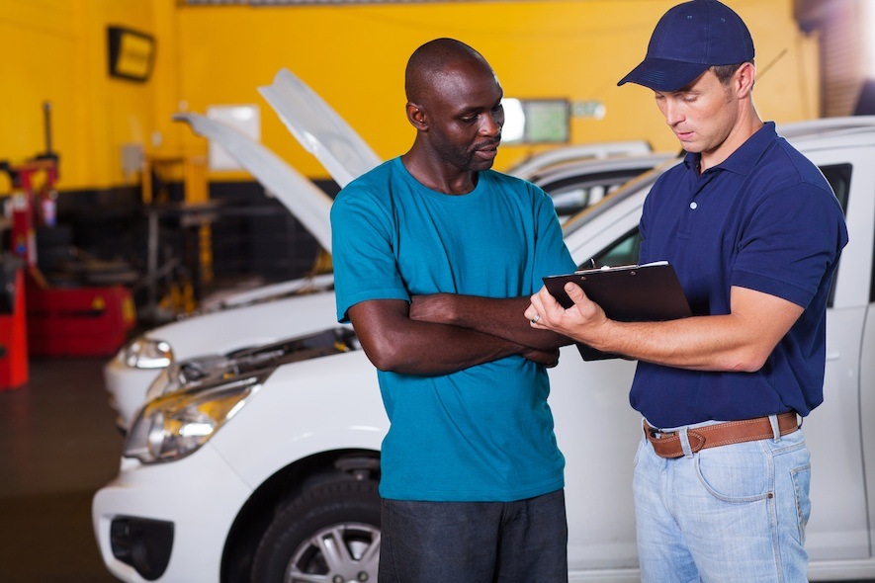


Trust your mechanic again.
Ryan, Pierre, Luke, Deitter, Adam
Number of interviews: 21
Number of interviews to date: 58
Notes:
Ryan

Slide 2

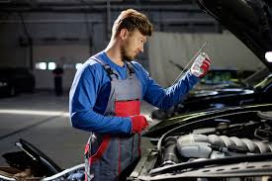




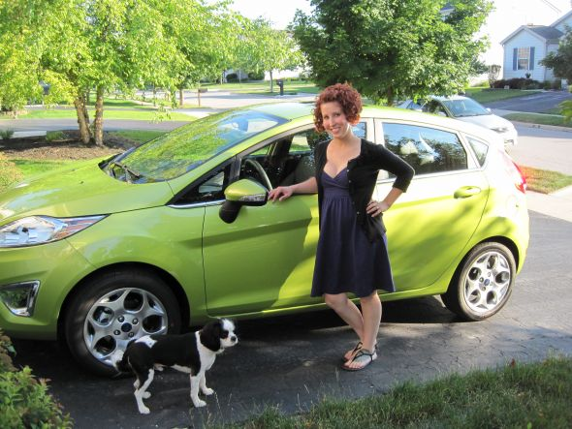

Business Concept
Notes:
Ryan

Slide 3
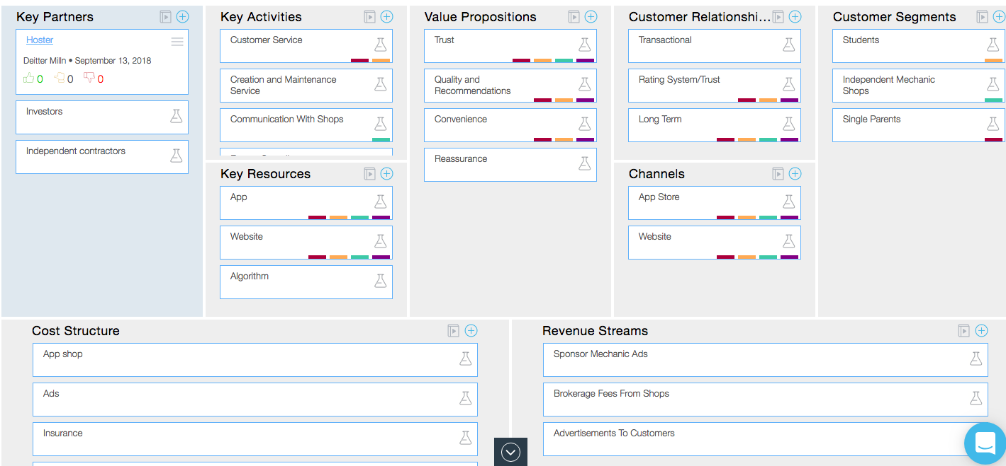
Week 1 Business Model Canvas
Notes:
Ryan

Slide 4
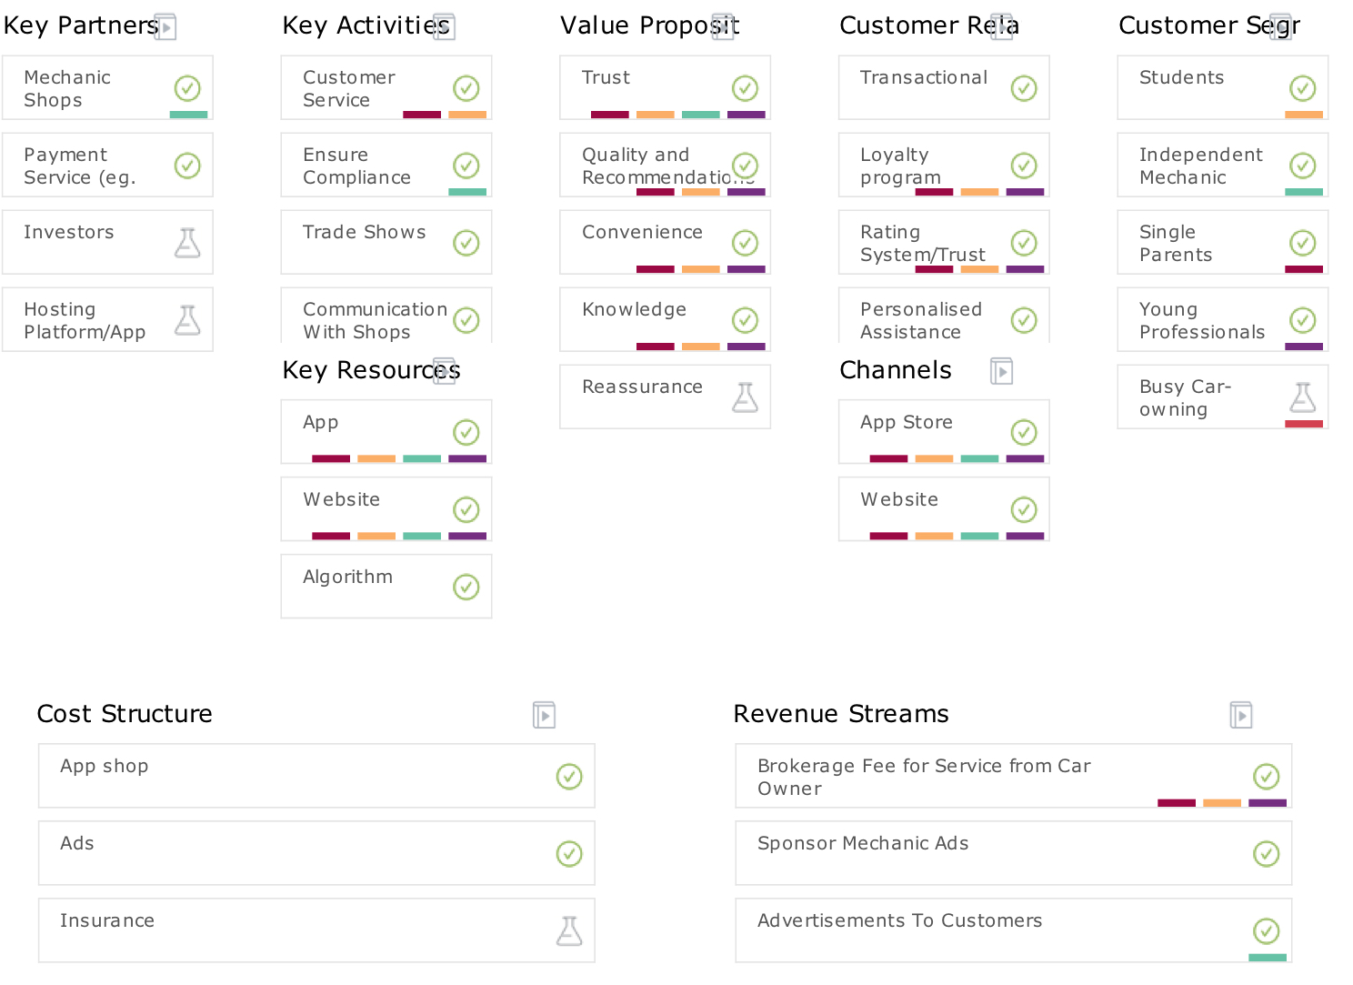
The Current Business Model Canvas
Notes:
Ryan

Slide 5

Customer Segment 1 | Original Single Parent
Location: Edmonton Area
Age: 30
# of kids: 2
Ages 4 & 6
Home Status: Townhouse (2-3 bedrooms)
Education: High school diploma + 2yr college diploma
Transportation: 2013 Honda Civic
Occupation: Receptionist
Expendable Income: Minimal
Expenses: Car payments, Mortgage, Grocery, Kid's activities
Hardworking – Very busy!
Comfortable with Technology
Makes Value-based purchases
Values: Routine, Safety, Kids, Independence, Reliability
Fears: disruption of routine and kids activities, lack of independence
Major pain point: unexpected expenses

Slide 6

Customer Segment 1 | Current Busy Edmontonian
Location: Edmonton Area
Age Range: 20-50
Includes: Single Parents, Students, & Professionals
Excess Income: Limited
Very busy
Makes VALUE-BASED purchases
Values: Time, Convenience, Trust
Fears: Disruptions
Major pain point: Unexpected expenses

Slide 7
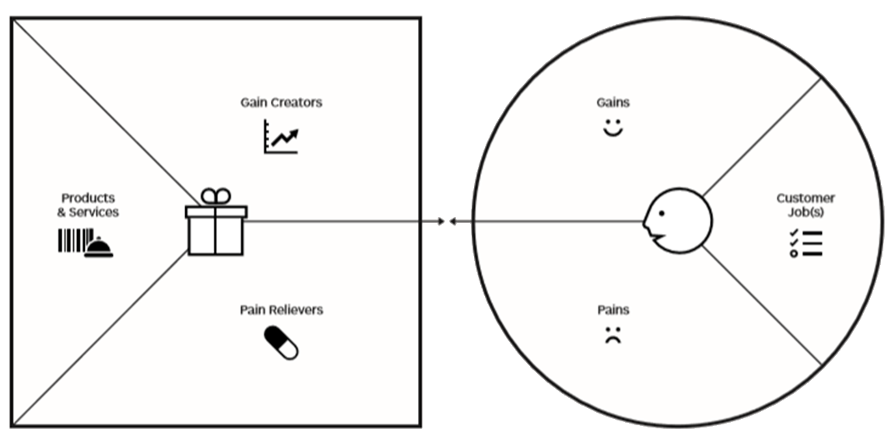
Busy Edmontonian Value Proposition Original
Bridging mechanic/ consumer gap
Cheaper Quote
More control
Faster Solutions
Trust Ratings
Time
Transporting themselves + others
Maintaining the app/web
Flexibility
Convenience
Repair of vehicle
Towing
Arrange transportation
Not trusting mechanic
Not having transportation
Car Appearance
Vehicle Replacement
Empowerment, Choices
Time Lost
Knowledge
Getting ripped off
Experience
Not knowing the problem

Slide 8
Busy Edmontonian Value Proposition Current
Bridging mechanic/ consumer gap
Cheaper Quote
More control
Faster Solutions
Trust Ratings
Time
Transporting themselves + others
Flexibility
Convenience
Repair of vehicle
Not trusting mechanic
Maintaining the app/web
Empowerment
Not having transportation
Car Appearance
Time Lost
Knowledge
Getting ripped off
Not knowing the problem

Slide 9
Busy Edmontonian Value Proposition The Evolution
Bridging mechanic/ consumer gap
Cheaper Quote
More control
Faster Solutions
Trust Ratings
Time
Transporting themselves + others
Maintaining the app/web
Flexibility
Convenience
Repair of vehicle
Towing
Arrange transportation
Not trusting mechanic
Not having transportation
Car Appearance
Vehicle Replacement
Empowerment, Choices
Time Lost
Knowledge
Getting ripped off
Experience
Not knowing the problem

Slide 10
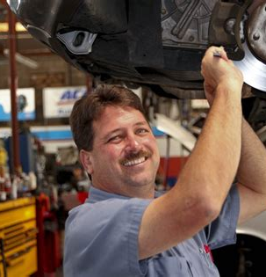
Customer Segment 2 | Original Independent Mechanic
Location: Edmonton Area
Excess Income: Medium (depending on success)
Business Expenses: Employees, Marketing, Rent, Tools/Parts, Training, Fees/Taxes
Not necessarily a businessperson
Extremely busy, focused, career-minded
Values: Reliability, Loyalty, Consistency
Fears: Loss of customers, damage to reputation
Major pain point: Lack of Customers

Slide 11
Customer Segment 2 | Current Mechanic Shop Owner
Location: Edmonton Area
Not necessarily a businessperson
Extremely busy, focused, career-minded
Values: Reliability, Loyalty, Consistency
Fears: Loss of customers, damage to reputation
Major pain point: Not utilizing all space

Slide 12
Mechanic Shop Owner Value Proposition Original
Rating System
Advertising resource
Resource for advertising
Connection to Customers
Get Customers
App/Website
Increased sales
Good work appreciated
(Rating System)
Fix their Cars
Database
Edge on competition
Not Enough Customers
Make money
Connection to Customers
Lots of Competition
Slow business periods
Notes:
1. Customer Jobs (Right Side)
2. Customer Pains (Right Side)
3. Customer Gains (Right Side)
4. Gain Creators
5. Pain Relievers
6. Products & Services

Slide 13
Mechanic Shop Owner Value Proposition Current
Rating System
Advertising resource
Resource for advertising
Connection to Customers
Get Customers
App/Website
Increased sales
Rating system
Fix their Cars
Database
Edge on competition
Not fully utilized space.
Make money
Connection to Customers
Lots of Competition
Slow business periods
Notes:
1. Customer Jobs (Right Side)
2. Customer Pains (Right Side)
3. Customer Gains (Right Side)
4. Gain Creators
5. Pain Relievers
6. Products & Services

Slide 14
Mechanic Shop Owner Value Proposition The Evolution
Rating System
Advertising resource
Resource for advertising
Connection to Customers
Get Customers
App/Website
Increased sales
Rating system
Fix their Cars
Database
Edge on competition
Not fully utilized space.
Make money
Connection to Customers
Lots of Competition
Slow business periods
Not Enough Customers
Notes:
1. Customer Jobs (Right Side)
2. Customer Pains (Right Side)
3. Customer Gains (Right Side)
4. Gain Creators
5. Pain Relievers
6. Products & Services

Slide 15
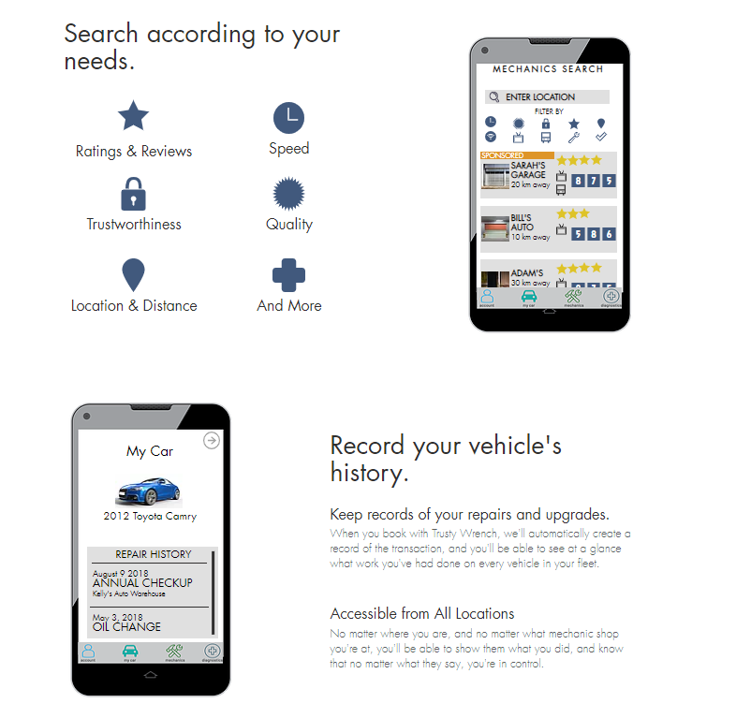
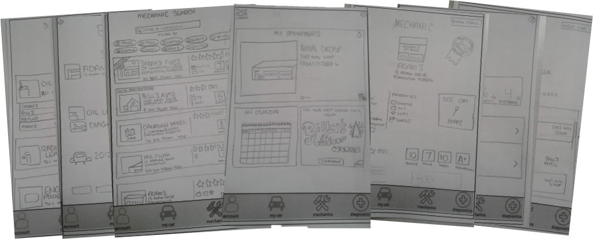
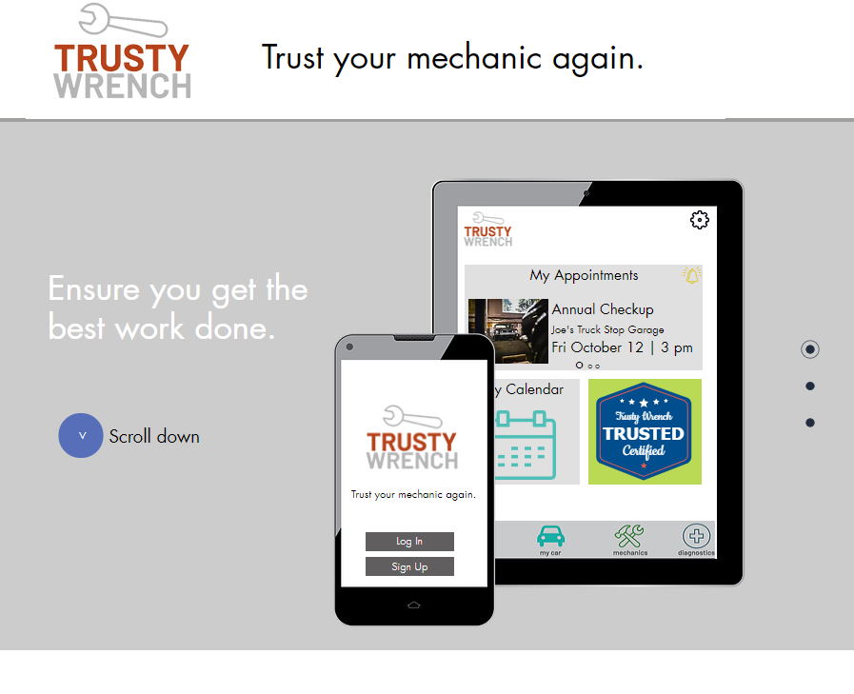
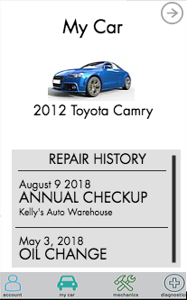
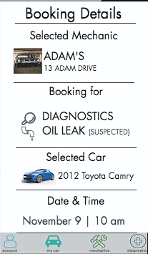
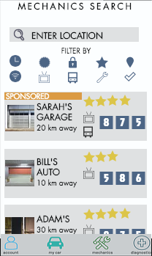
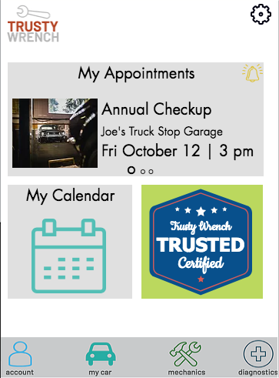
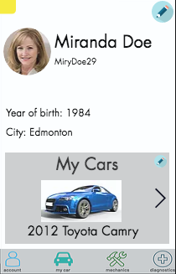
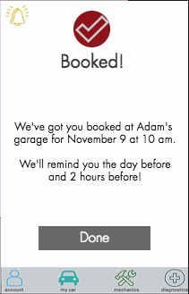
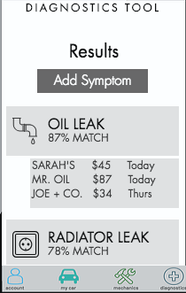
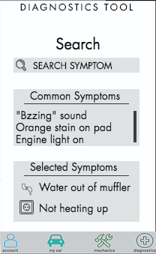

The Original Minimum Viable Products

Slide 16

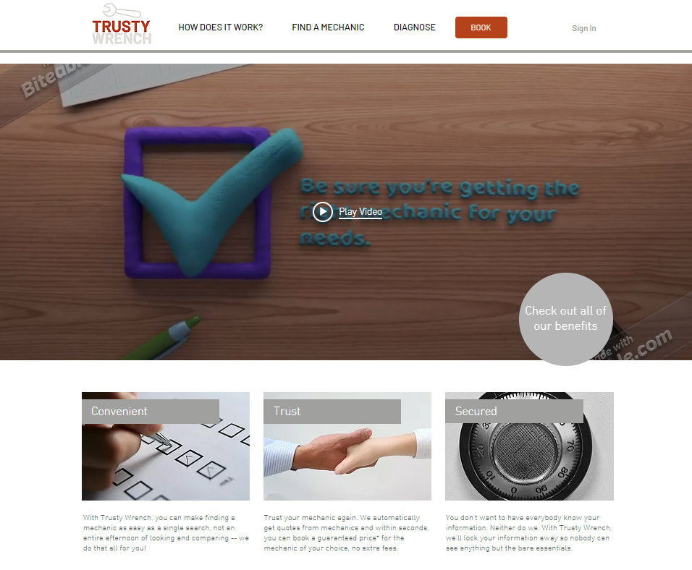

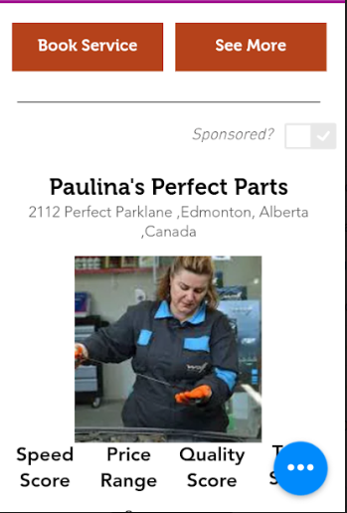
Our Current Minimum Viable Product

Slide 17
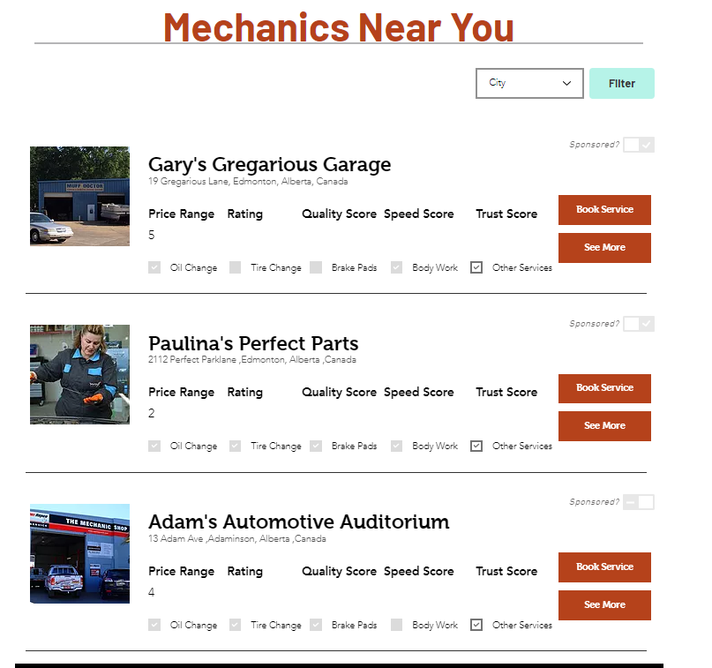
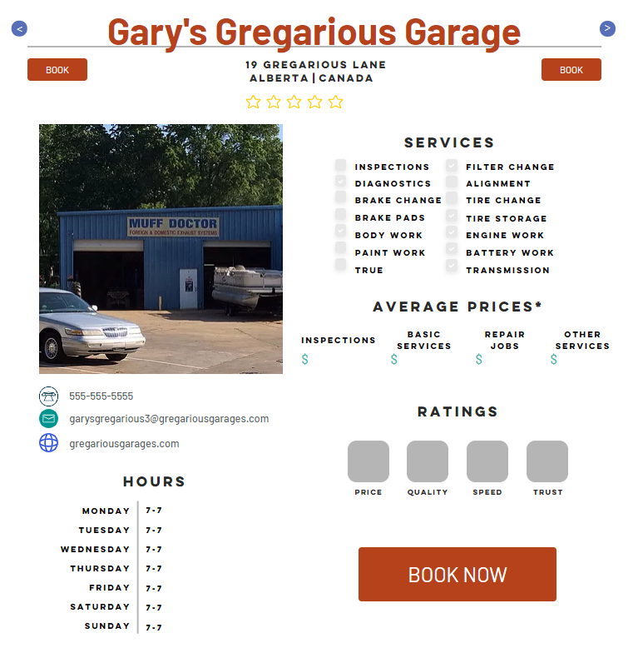
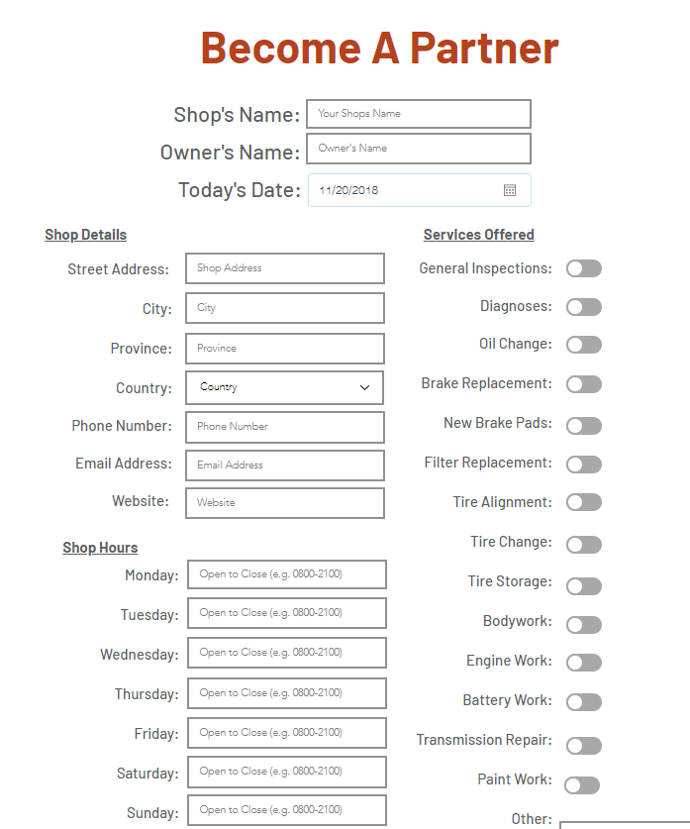
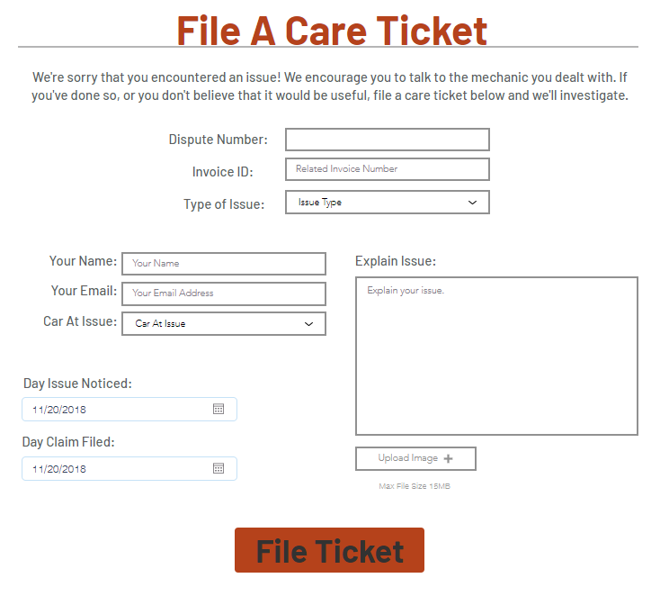
Our Current Minimum Viable Product

Slide 18
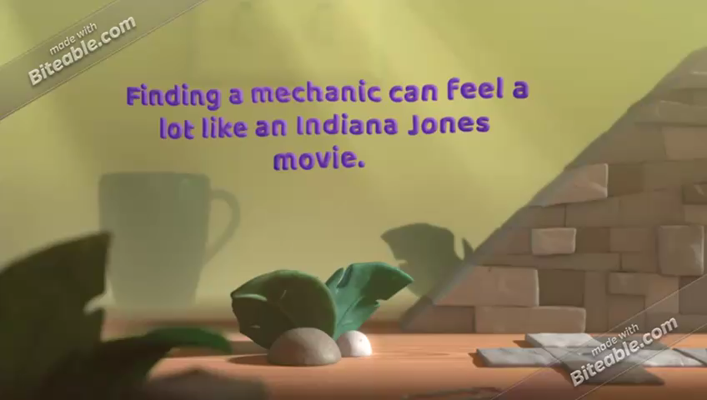
Our Current Minimum Viable Product 2

Slide 19






Direct
Competitors
Indirect

Slide 20
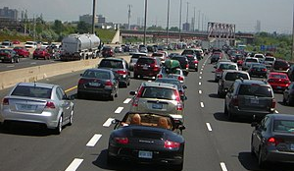
Market Size Car Owners
TAM: 3.4 million cars registered in Alberta
SAM: 700,000 cars registered in Edmonton,
- 82% is 574,000 cars
Target Market Year 1: 287,000 (50% of SAM)
Target Market Year 2: 344,400 (20% increase)
Target Market Year 3: 574,000 (40% increase, up to SAM)
22 million cars in Canada in 2017
2 million new cars sold in Canada 2017
At any time, 4 million under warranty
18% of cars
Notes:
Ryan

Slide 21
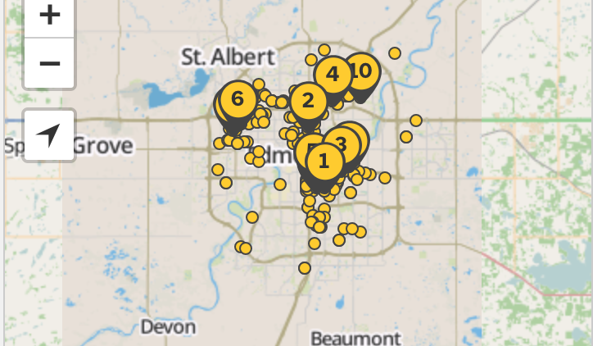
Market Size Mechanic Shops
TAM: 636 shops (Independent and Chain, Edmonton Area)(YellowPages)
SAM: Of 437 in Edmonton, 150 are Independent
Target Market Year 1: 15 (10% of SAM)
Target Market Year 2: 45 (3x increase)
Target Market Year 3: 90 (2x increase)
Notes:
Ryan

Slide 22
Customer Relationships Busy Edmontonian
[Describe your top 2 methods to GET, KEEP, and GROW your customers] – loyalty program for example
Get
Online ads
Grow
Loyalty Program
Keep
Word of mouth
Premium Service
Customer Care
Keeps track of vehicle repair history

Slide 23
Customer Relationships Mechanic Shop Owners
[Describe your top 2 methods to GET, KEEP, and GROW your customers]
Get
Sales force
Grow
Premium Services
Keep
Analytics
Other mechanics sharing TW
Promoted Mechanic
Only pay if you get results
Customer Care

Slide 24



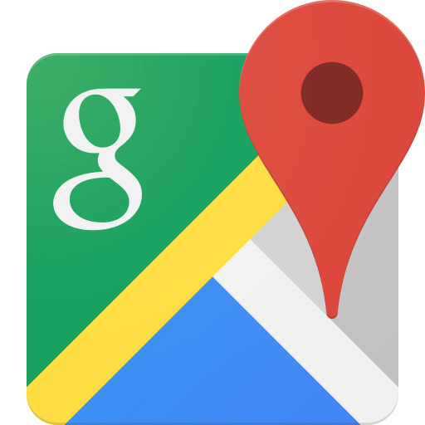
Marketing Channels Busy Edmontonian
[Marketing Channels]
Briefly describe how you plan to let your customers know about your business
Google Ads
Ads on common search terms on Google.
-
Free Search Result
~$2.46 click/~$0.10 view
Facebook Ads
Ads in micro targeted Facebook user’s feeds
-
~$7.99 for 30,000 views
Word of Mouth
Customers sharing their experiences
-
Free
Map Ads
Appears at top of “mechanic” Map searches
-
~$2.46 click (US)
~$0.10 view (US)

Slide 25

Marketing Channels Mechanic Shop Owner
[Marketing Channels]
Briefly describe how you plan to let your customers know about your business
Google Ads
Ads on common search terms on Google.
-
Free Search Result
~$2.46 click/~$0.10 view
Sales Force
Sales force that goes out to mechanics and talks to them.
-
Base salary + commission
Word of Mouth
Mechanics tell other mechanics
-
Free

Slide 26
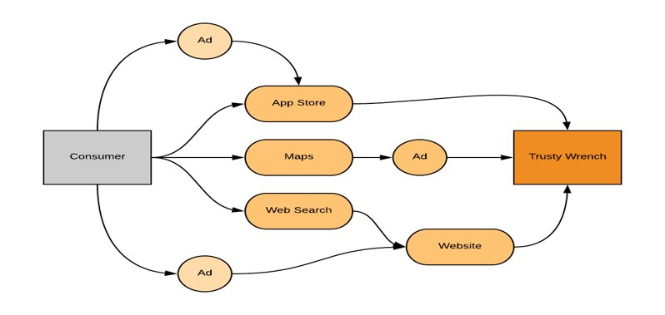
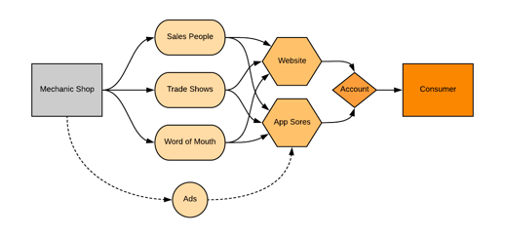
Customer Segment 1 & 2 Distribution Channels

Slide 27


Revenue Streams
Commission from Mechanics
2-5% commission on purchases, with a $10 cap per purchase.
Phased in slowly.
Commission From Customer
10% commission, baked into the price, with a cap, per purchase. Phased in.
Auxiliary Services
Promoted ads for certified mechanics
Trusty Wrench Certified partner program

Slide 28
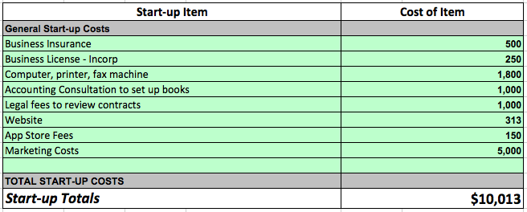
Cash Flow | Year 1
Start Up Costs
Up to
$10,013
Notes:
Ryan

Slide 29
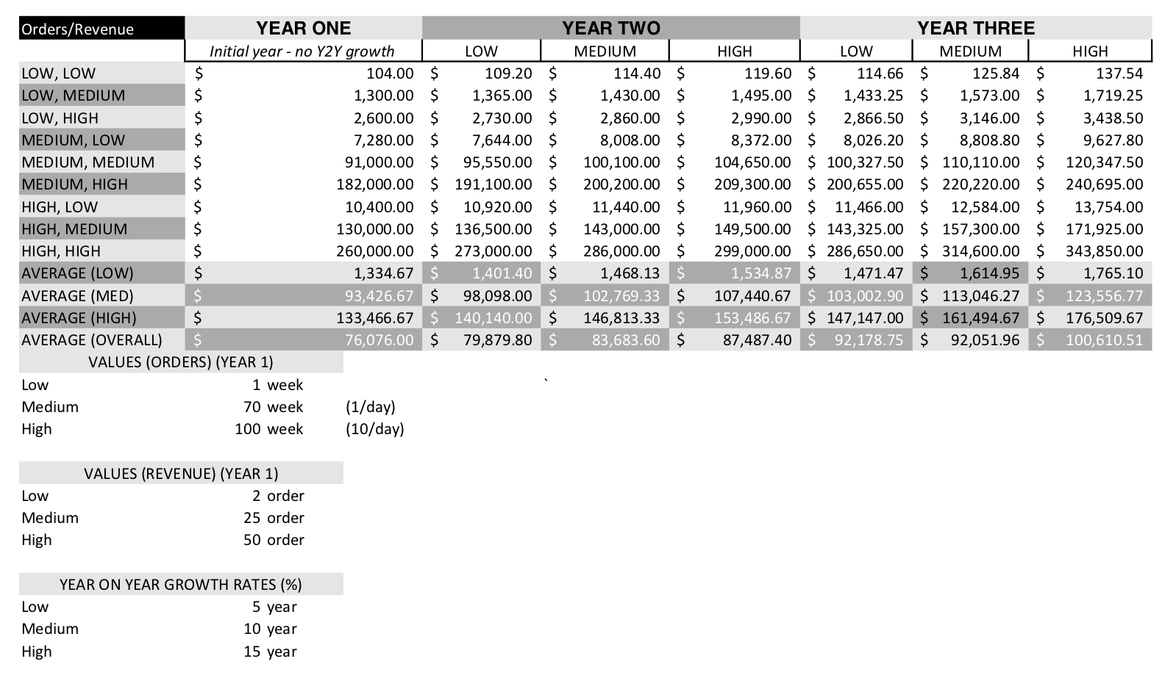
Cash Flow | Year 1 - 3 Revenue Estimate
Average year 1
$76,076
Average year 2
$83,683
Average year 3
$100,610
Notes:
Ryan

Slide 30
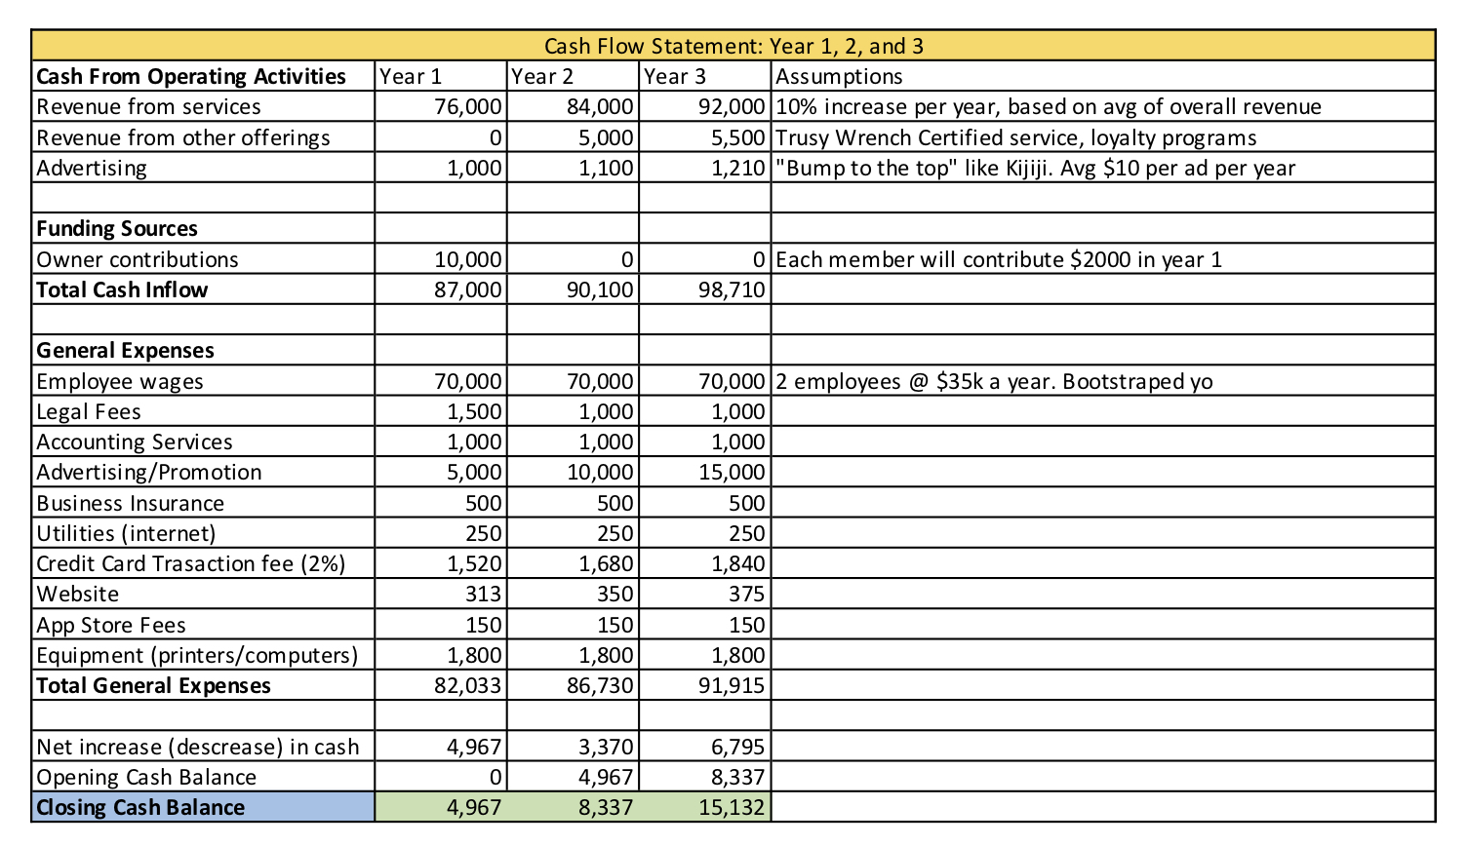
Cash Flow Years 1 - 3 Statement
Notes:
Ryan

Slide 31
Key Partners
[Use as many slides as you need.]
[List potential partners, why you need them, and what the risks are]
[What are the costs of these partnerships?]
[What are the benefits and barriers for these partners?]
[Diagram the activity and value flows with partners; include any economics.]
 | Why are they Key? | Benefits to Partner | Barriers | Cost
Mechanic Shops​ | The backbone of our business | Free Marketing, Revenue, Increased Market Share | Trust | Transportation
Payment Provider​ | To facilitate our payments | Revenue | No Barriers | 2.9% Transaction Fee +$0.30
App Provider​ | To host and allow us to provide our service | Revenue | No Barriers | $5.00/Month
Website Host​ | To host and allow us to provide our service | Revenue | No Barriers | $22.50/Month

Slide 32
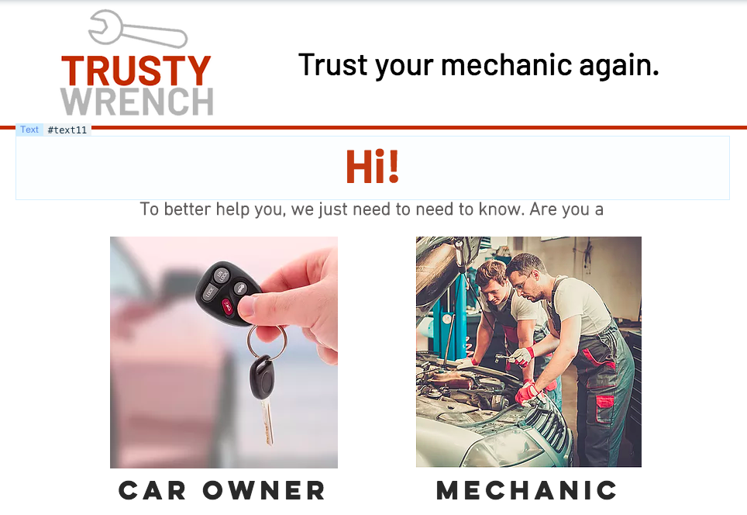

Key Resources
App
Website
Algorithm
Our Relationships
Notes:
Same format as the Revenue Stream or Marketing Channels

Slide 33
Key Activities
[Use as many slides as you need.]
[What are your key activities?]
[How do each of your key activities relate to your Customer Segments and Value Proposition?]
Customer service
Ensure compliance
Communication with garages
Notes:
Same format as the Revenue Stream or Marketing Channels

Slide 34
Customer Development & Research Car Owners
Interview Difficulty It got easier as we went along
Methods Interviewed In person, survey, form, telephone
Key Points Transparency, convenience, trust important
Number Interviewed Forty-eight
How did it change us? Pivoted on reviews & what we offered

Slide 35
Customer Development & Research Mechanic Shops
Interview Difficulty Hard to get their defenses lowered
Methods Interviewed In person, telephone
Key Points Do not force a bidding war OR schedule them
Number Interviewed Ten
How did it change us? Pivoted on scheduling and pricing

Slide 36
Takeaways
Ideas need to be worked on
01
Ask open ended questions
02
Get out of the building
03
Pivot when required
04
The customers build the business.
05

Slide 37
Thank you!
We would like to thank all the experts for coming in and sharing their time with us!
Trusty Wrench would like to thank Drew for facilitating this amazing opportunity.
We’d like to thank our fellow classmates for feedback and Launchpad information.

Slide 38
References
Main, K. (2018, November 5). How much does Google advertising cost? FitSmallBusiness.Com. Retrieved from https://fitsmallbusiness.com/google-advertising-cost/
Google. (nd).Twitter [Twitter account]. Retrieved from https://twitter.com/google
App Store Preview. (2018). Yelp: Local Food & Services. Retrieved from https://itunes.apple.com/us/app/yelp-local-food-services/id284910350?mt=8
Direct Booking. (2018). Facebook [Facebook account]. Retrieved from https://www.facebook.com/directbooking.ro/
Fiix. (2018). Maintenance Assistant rebrands to Fiix. Retrieved from https://www.fiixsoftware.com/news/maintenance-assistant-rebrands-to-fiix/
Hudsons. (n.d.). Auto Repair & Fleet Maintenance in Chesapeake, Virginia. Retrieved from https://www.hudsontow.com/auto-repairs.html
Volkswagon. (n.d.). Compass Volkwagon. Retrieved from https://www.compassvw.com/blog/where-to-have-your-vehicle-serviced-in-middletown-ny/mechanic-talking-with-car-owner-with-clipboard-in-hand_b/
Kinni, T. (2016, March 31). People Management by Algorithm. Retrieved from https://sloanreview.mit.edu/article/tech-savvy-people-management-by-algorithm/
Workshop Whisperer. (2016, July 13). 5 Reasons You Should Target More Female Customers For Your Auto Repair Business. Retrieved from http://workshopwhisperer.com/5-reasons-you-should-target-more-female-customers-for-your-auto-repair-business/
Gordon, A. (n.d.). Mechanic Logo Design [Pinterest account]. Retrieved from https://www.pinterest.ca/pin/245516617166138337/?lp=true
Peoplecreations / Freepik. (2017). Mechanic showing customer the problem with car Free Photo. Retrieved from https://www.freepik.com/free-photo/mechanic-showing-customer-the-problem-with-car_1005174.htm
Freelancer. (n.d.). car-dealership-logo-8. Retrieved from https://www.freelancer.com/contest/car-dealership-logo-easy-and-quick-100900-byentry-3661732.html
Yellow Pages. (n.d.). Retrieved November 28, 2018 from https://www.yellowpages.ca/search/si/1/Car+Repair/Edmonton+AB
https://open.alberta.ca/dataset/553f5a93-0032-484a-b5d3-bcfd8c47bc11/resource/0f7bbb26-f854-4d24-8379-f63e0a7b8f98/download/vehstyle2018.pdf
https://www150.statcan.gc.ca/t1/tbl1/en/tv.action?pid=2310006701
https://www150.statcan.gc.ca/t1/tbl1/en/cv.action?pid=2010000101#timeframe

